Slide 1
Modeling Choice and Count Data

Slide 2
Overview
•Transportation planners deal with many types of
data
•Qualitative and count data are not well suited to
linear models (i.e., ordinary least squares)
•Logit and probit models can handle choice data
•Poisson and negative binomial models can
handle count data

Slide 3
Qualitative/Discrete Choice Data

Slide 4
Qualitative Choices
Although transportation planners deal with a lot of quantitative data, most of the behavioral mechanisms are qualitative in nature.
No one really chooses how many miles to drive on a given day. Instead, they choose to drive or not drive from one location to another.
People choose whether to own a car, where to live, whether to take transit, and which route to choose.

Slide 5
The Random Utility Model
Consumer Choice Theory: people make choices to maximize utility.
Utility is unobservable but a function of preferences, trips characteristics, modal characteristics, route characteristics, etc.
Utility is ordinal (not cardinal) in nature

Slide 6
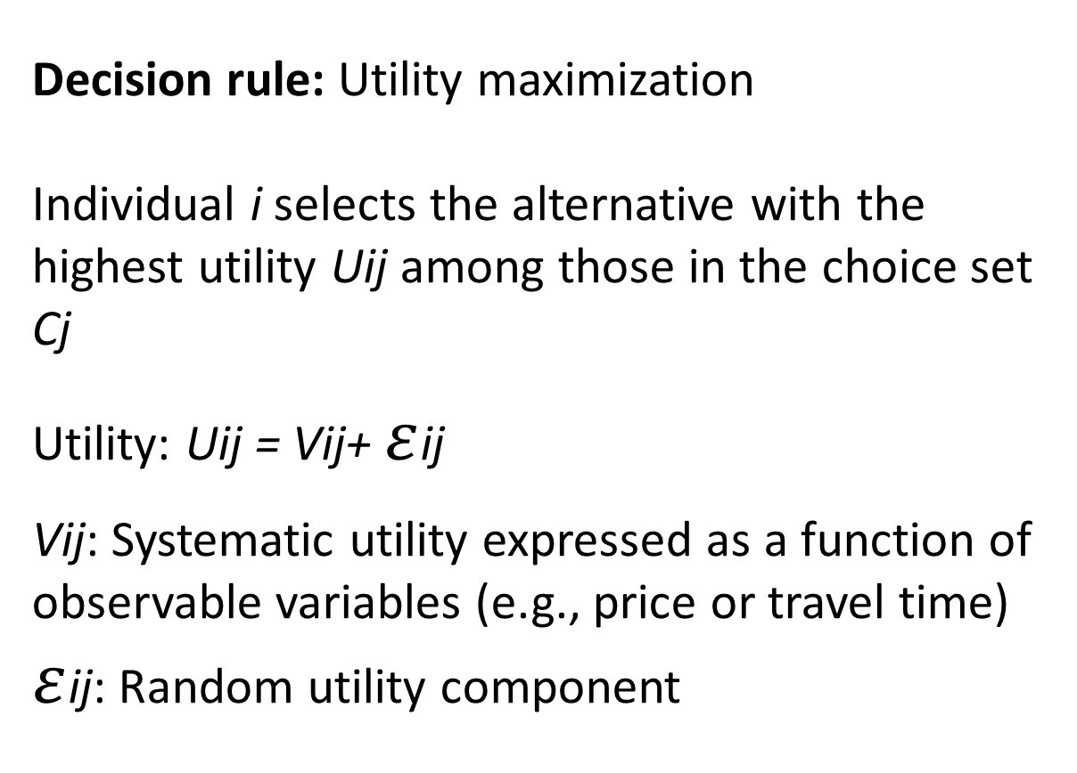
The Random Utility Model
Decision rule: Utility maximization
Individual i selects the alternative with the highest utility Uij among those in the choice set Cj
Utility: Uij = Vij+ $ε$ij
Vij: Systematic utility expressed as a function of observable variables (e.g., price or travel time)
$ε$ij: Random utility component

Slide 7
Systematic Utility
Attributes: describing the alternative
–Generic vs. Alternative Specific
Examples: travel cost, travel speed
–Quantitative vs. Qualitative
Examples: quality
Characteristics: describing the decision
maker
–Socioeconomic

Slide 8
Random Terms
•Distribution of error
•Variance/covariance structure
–Correlations between alternatives
–Multidimensional decision (e.g., household location and mode)
•Typical models:
–Probit (normal error)
–Logit (“Extreme Value” error)

Slide 9
Framework
Decision-Maker
Individual (person/household)
Socio-economic characteristics (e.g., age, gender, education, income)
Alternatives
Decision-maker i selects one and only one alternative from a choice set C={1,2,…,J} with J alternatives
Attributes of alternatives (e.g., price, quality)
Decision Rule
Highest utility

Slide 10
Framework
Decision-Maker
Individual (person/household)
Socio-economic characteristics (e.g., age, gender, education, income)
Alternatives
Decision-maker i selects one and only one alternative from a choice set C={1,2,…,J} with J alternatives
Attributes of alternatives (e.g., price, quality)
Decision Rule
Highest utility

Slide 11
Binary Logit Model

Slide 12
Logit model
Predicting qualitative events/discrete outcomes:
Transit (ride or not)
Employed (yes; no)
Housing (own; rent)
Vote for referendum (yes; no)
If we use OLS, problems encountered – both in terms of model specification & estimation.

Slide 13
Binary Choice
Individuals face 2 choices; make choices based on attributes of themselves & “choice sets”.
Aim: determine the probability that an individual with a given set of attributes will make one choice (with a set of attributes) over another
i.e., model that predicts the probability that an individual with an income of $60,000 and who owns a home will vote for a transportation sales tax referendum.

Slide 14
Binary Choice
Predicting Binary Variable using OLS Linear Model
Yi = α + βXi + Ei (Yi = 0 or 1)

Slide 15
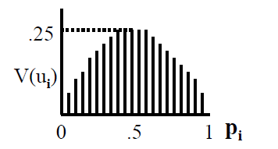
Binary Choice
Predicting Binary Variable using OLS Linear Model
Error variances are not homoschedastic. Observations for which probability close to 0 or 1 will have relatively low error variances while cases where probability close to 0.5 will have higher ones.
Thus, using OLS yields:
(1) inefficient parameter estimates;
(2) incorrect estimates of standard errors,
invalidating statistical tests of significance
(3) Strange predictions

Slide 16
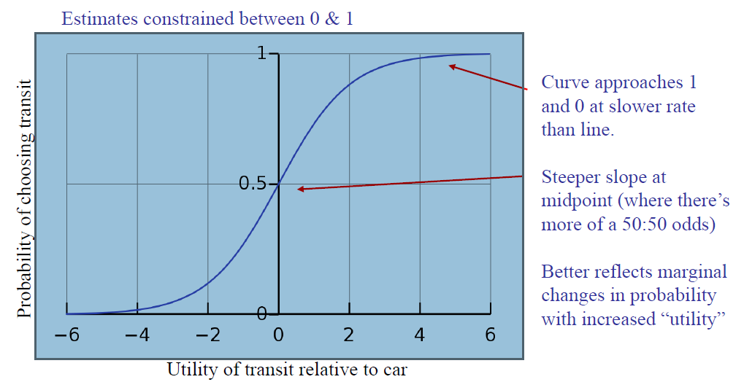
Logistic curve
provides probability estimates from 0 to 1;
(2) better captures changes in probabilities

Slide 17
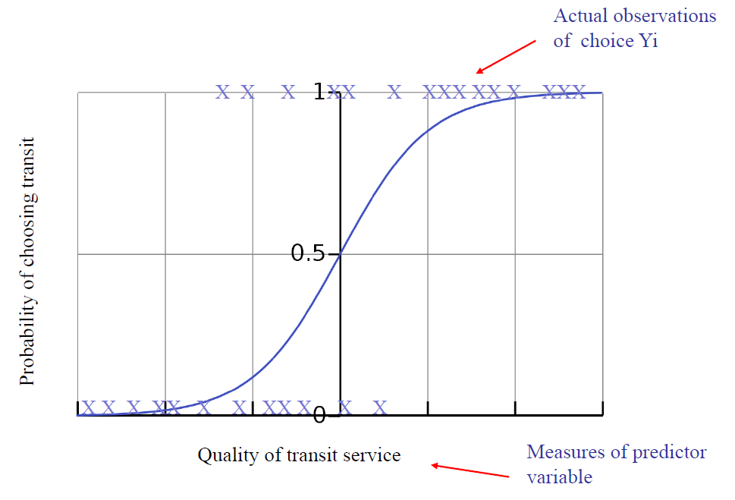
Logit models
Notes:
And this corresponds with high transit use and NMT

Slide 18
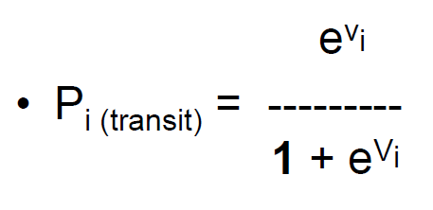
Logit model
Is the utility from transit highest?
Utility: Ui= Vi+ Ei
Vi: Systematic utility expressed as a function of observable variables Vi == B0 + X1B1 + X2B2 …
Ei: Random utility component (captured in functional form)

Slide 19
Logit model
Binomial logit example in R
Specification
Interpretation (utility and odds ratios)

Slide 20
Multinomial Logit

Slide 21
Multinomial Structure
Multinomial discrete choice
Yi
= mode choice(driver, passenger, transit)
= housing choice(single-family home; condo; rent)
= voting choice(for; against; abstain)
Logit Estimate, where categories of Yi= 1, 2, 3, …., J-1, J

Slide 22
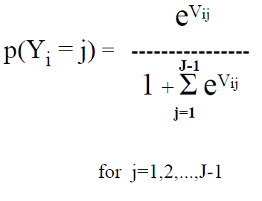
Multinomial Structure
Structural form

Slide 23
Multinomial Structure
Multinomial discrete choice
Yi
= mode choice(driver, passenger, transit)
= housing choice(single-family home; condo; rent)
= voting choice(for; against; abstain)
Logit Estimate, where categories of Yi= 1, 2, 3, …., J-1, J

Slide 24
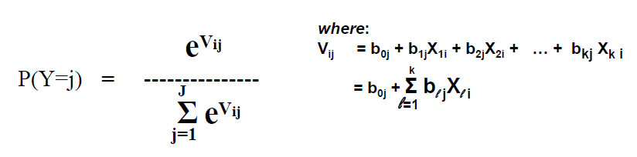
Multinomial Interpretation
Logit equation yields values between 0 & 1.
Since the curve is non linear, changes in X on Y are not constant. (They’re close to constant at p= 0.5)
Signs on the coefficient: show direction of relationships. Large positive Vi = high utility;
Parameter estimates have standard errors, so significant tests can be conducted on each variable

Slide 25
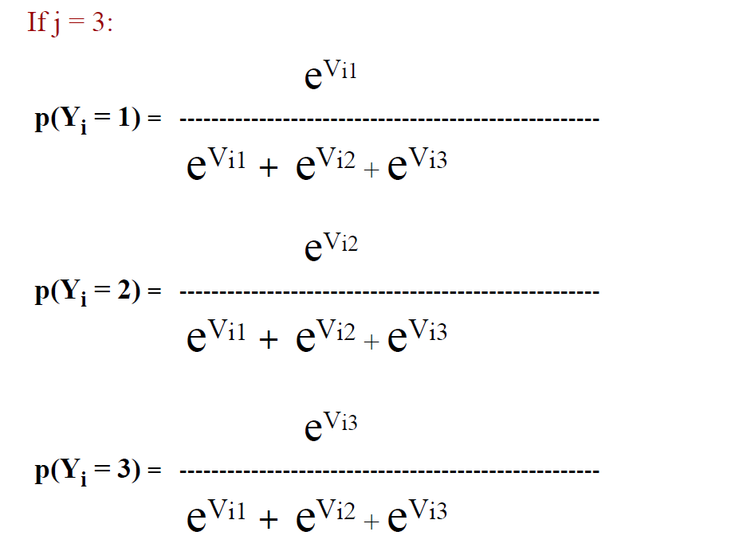
Multinomial Example

Slide 26
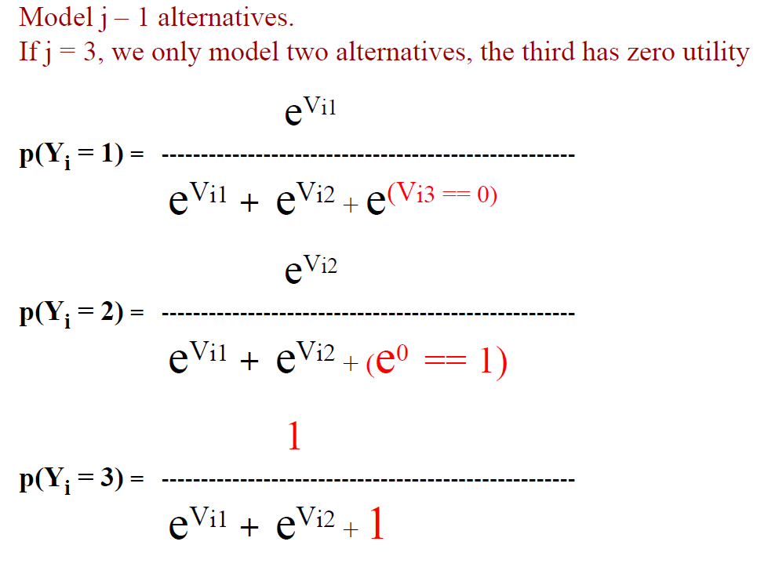
Multinomial Example

Slide 27
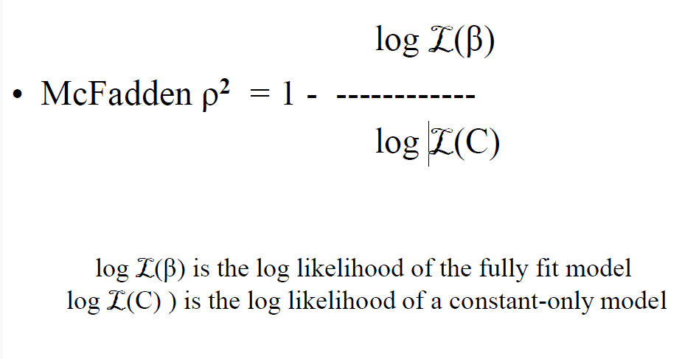
Fit Statistic

Slide 28
Fit Statistic

Slide 29
Modeling Count Data

Slide 30
Count data
# of incidences … over time (per year) or space (per square mile)
Usually used for rare events.
Examples:
# of traffic collisions per year
# of air quality violations per year
# of foreclosed homes per square mile
# medical clinics per square mile
With small # of incidences and given the non-normal nature of data, OLS regression is inappropriate.

Slide 31
Count data

Slide 32
Count data
Poisson and negative binomial models are the place to start

Slide 33
Summary and conclusion

Slide 34
Summary
Transportation planners deal with many types of data
Qualitative and count data are not well suited to linear models (i.e., ordinary least squares)
Logit and probit models can handle choice data
Poisson and negative binomial models can handle count data

Slide 35
Extra slides

Slide 36
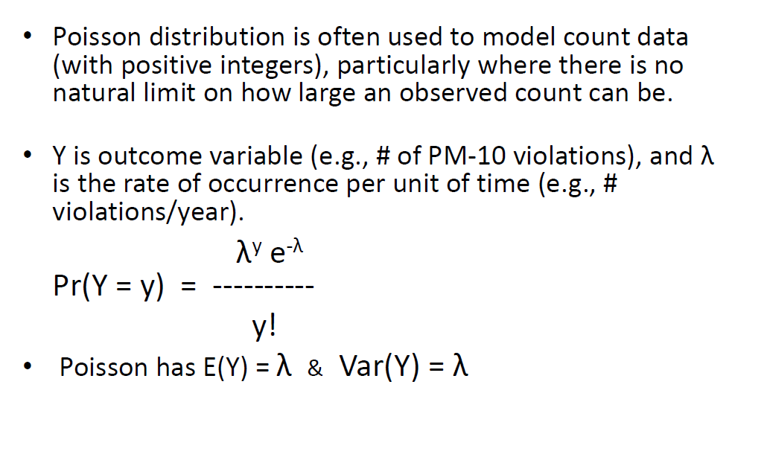
Poisson Distribution

Slide 37
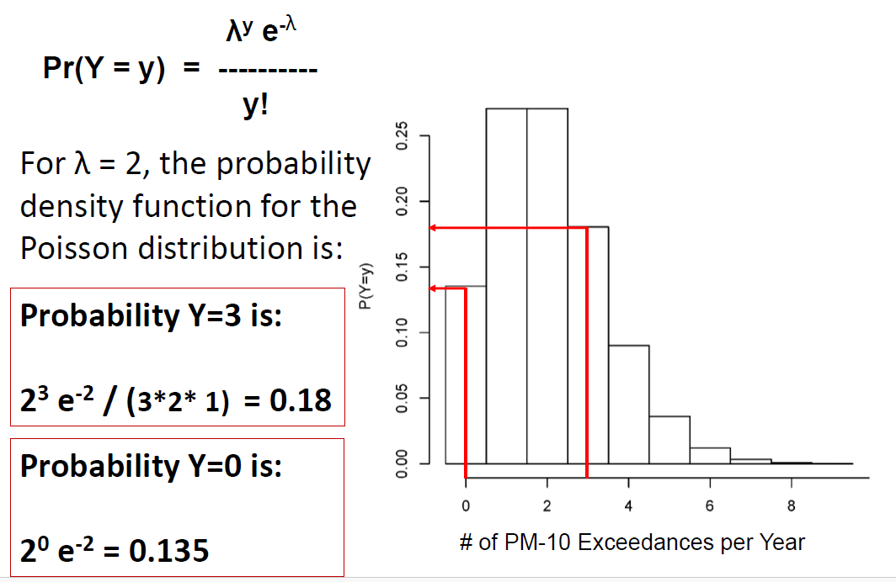
Poisson Distribution

Slide 38
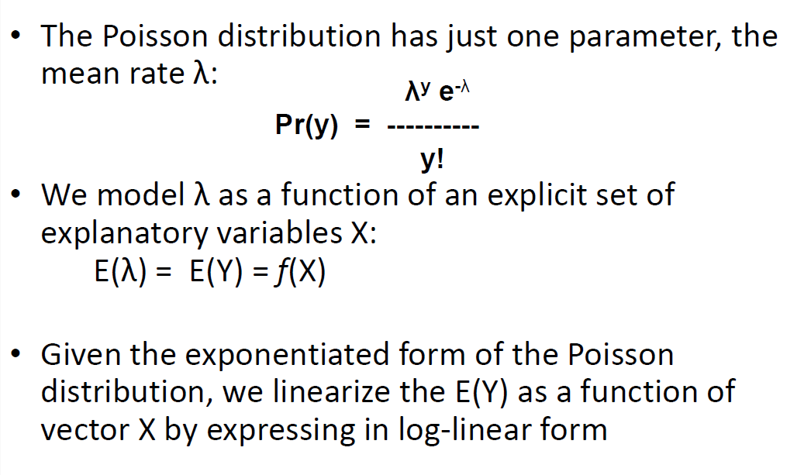
Poisson Distribution

Slide 39
Poisson Distribution
Over-Dispersion
Poisson Distribution assumes mean = variance; if variance is considerably more, the data are Over-dispersed. Over-dispersed data have standard errors and p-values that are too small (over-stating fit).
Estimate using Negative Binomial Regression. Handles over-dispersion; also more robust –handles count data that are not rare
Checking for over-dispersion:
Examine the ratio of deviance to the degrees of freedom … should be close to 1.
Look at predictions of zero and check formal tests

